Slide 1


Yelp Multi-Label Classification
Emilien NORY

Slide 2
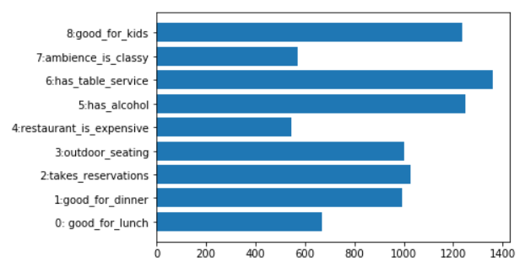
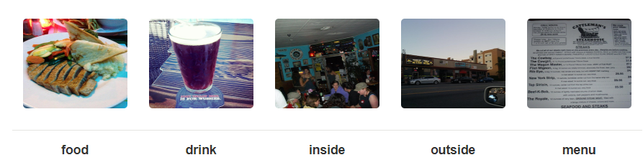
YELP Restaurant
Number of pictures per label :
There are 234 842 training images with the following labels on the image:
Good for lunch
Good for dinner
Take reservations
Terrace available
Restaurant is expensive or not
Serves alcohol
Serves at Table
The atmosphere is classy
Good for the kids.

Slide 3
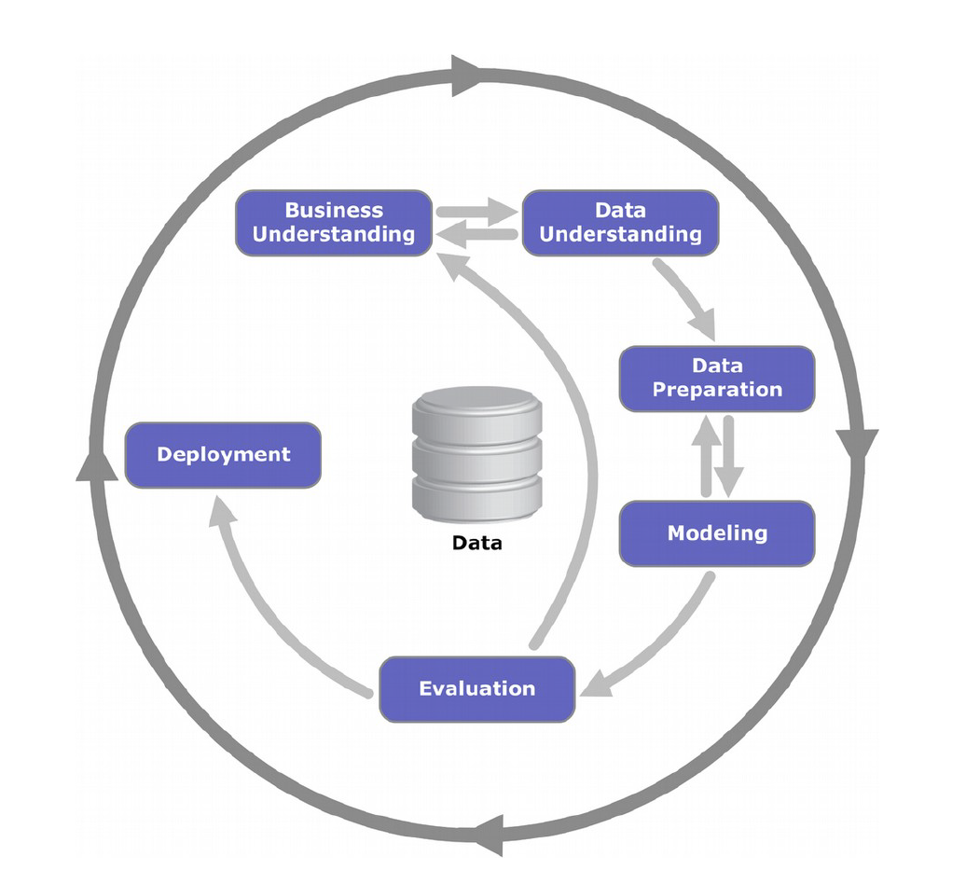
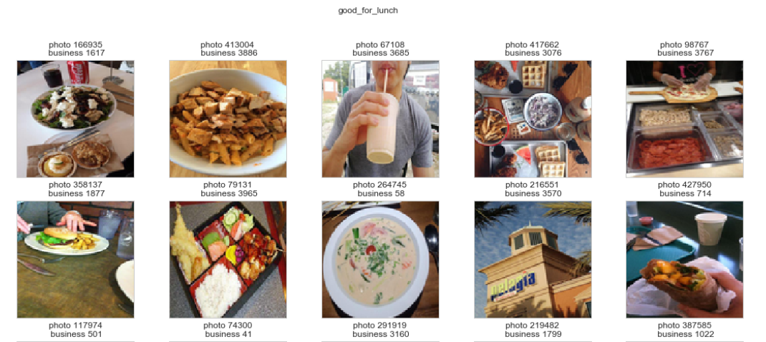
Exploratory data analysis
This is a multi-instance multi-label (MIML) classification problem. Each business has multiple photographs (117 images on average, see eda.ipynb) and predictions need to be made at the business level. We have then two options.
The first one is to derive a feature vector for each instance and combine them accordingly to get one feature vector per business. These inputs can then be used in a standard supervised learning task. The second option is to assign to each instance the label of its corresponding business and proceed to classification. Then, the output probabilities are averaged for each label. We have investigated the second option.
Also, multiple labels can be assigned to each business. This means it is necessary to take the label dependencies into account for classification.

Slide 4
Data Pre-processing
First, we want to endoce labels.
Train and test split :
There are 176131 images in the training dataset
There are 29355 images in the validation dataset
There are 29356 images in the test dataset

Slide 5
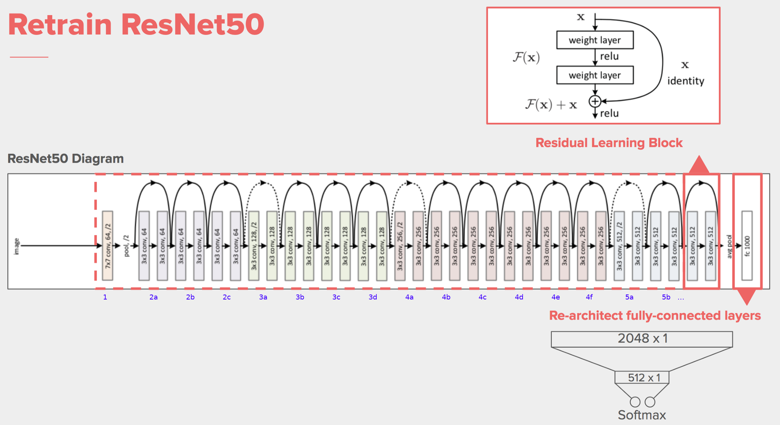
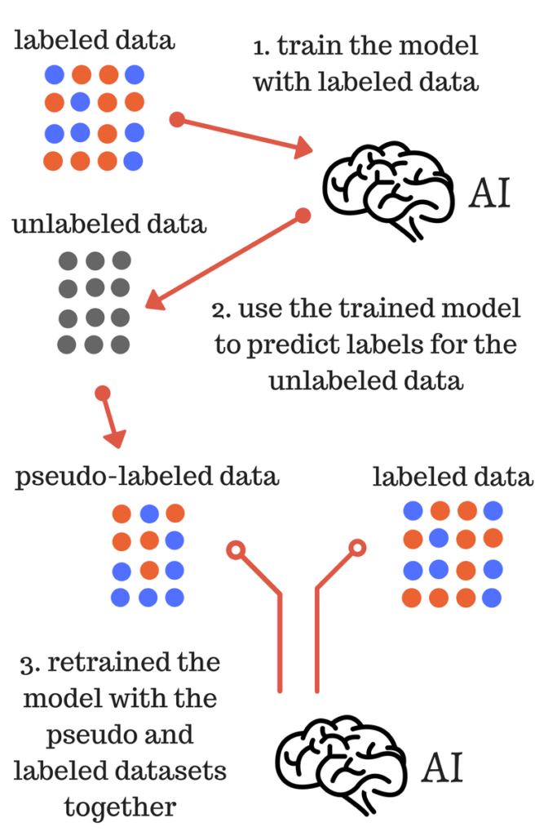
ResNet50 model Architecture

Slide 6
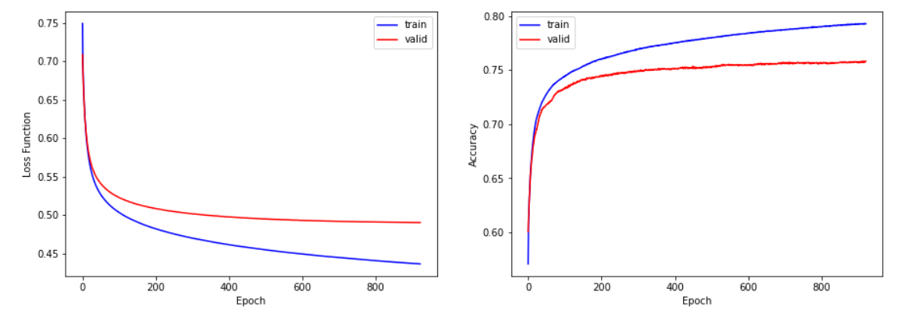
Result
Addition of the supervision layer
F1 score: 0.76
Accuracy : 0.75

